Slide 1
JBOSS APP Server
INSTALATION

Slide 2
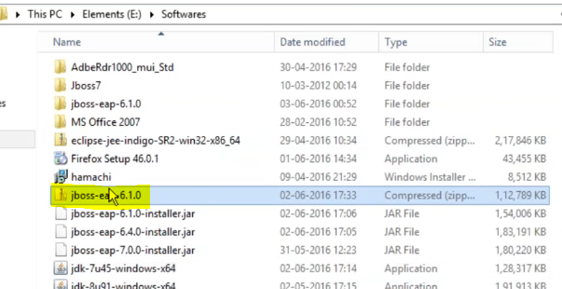
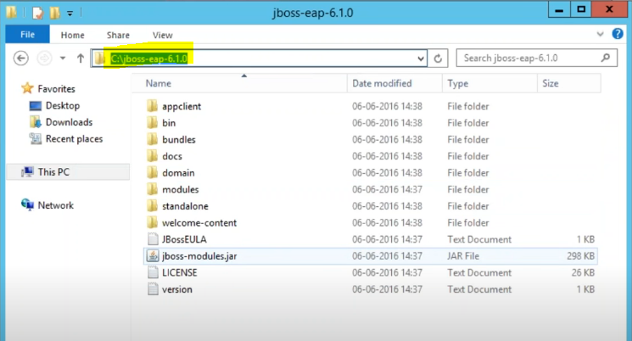
JBOSS INSTALATION
Download JBOSS from REDHAT site
Download the required version as per Infa MDM PAM sheet.
Mostly JBOSS will be available in Enterprise.

Slide 3
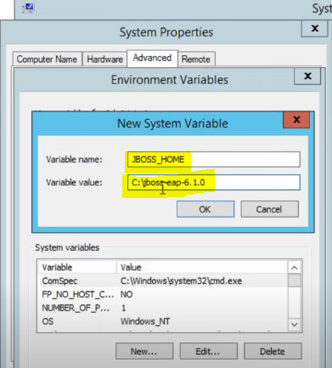
JDK INSTALATION
Set JBOSS_HOME path

Slide 4
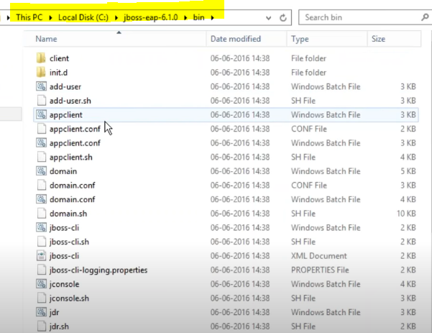
JDK INSTALATION
“Bin” Folder in JBOSS

Slide 5
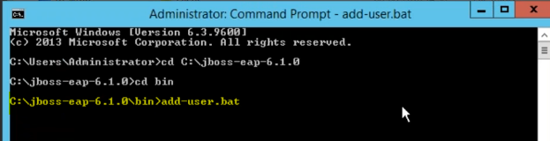
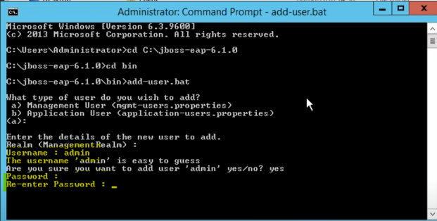
JDK INSTALATION
Add user to Jboss – This is part of JBOSS installation. Not related to MDM.

Slide 6
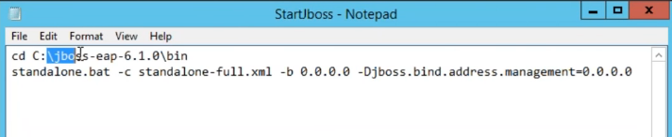
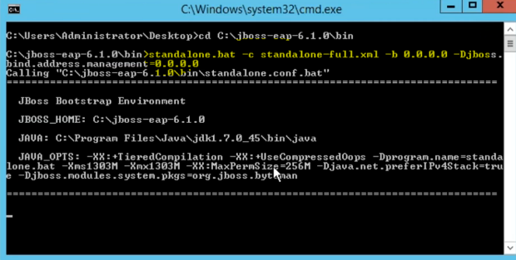
JDK INSTALATION
Start JBOSS

Slide 7
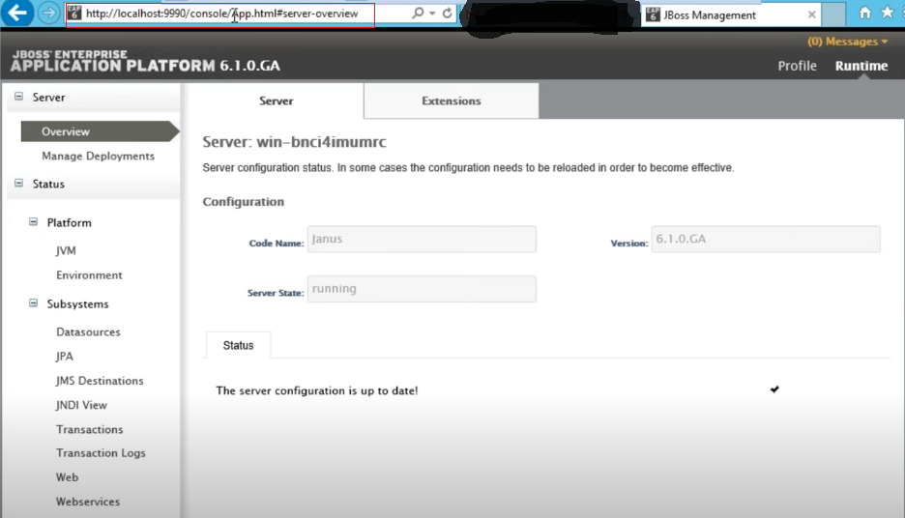
JDK INSTALATION
If JBOSS started successfully, you will be able to access JBOSS management UI.
Use the Host and port.
Use the user which you created in previous step, to login

